Slide 1

Talking
about
Prehab
Notes:
Online house keeping rules
Ensure video link is cued up at 2:36 SPEAKERS!
Ask participants to introduce themselves to their immediate neighbours
Name tags?

Slide 2
What to expect
TaP
TaP
45 minutes
1 screen
Share your experience
Notes:
1 screen please, if you are expecting an important call please step out of the room
this is an informal session that relies on you sharing your experience

Slide 3
Learning Objectives
TaP
Gain a better understanding of Prehab
Feel more confident talking about Prehab with a person diagnosed with cancer
Feel more confident about when to talk about Prehab
Talking
about
Prehab
Notes:
Our learning outcomes, please consider if you think these were met when you feed back on this session

Slide 4
Prehabilitation can be defined as
TaP
“a process on the cancer continuum of care that occurs between the time of cancer diagnosis and the beginning of acute treatment and includes physical and psychological assessments that establish a baseline functional level, identify impairments, and provide interventions that promote physical and psychological health to reduce the incidence and/or severity of future impairments.”
Silver et al. CA Cancer J Clin, 2013
Notes:
This is how NHS Scotland defines Prehabilitation.
(let them read it)

Slide 5
Prehab
TaP
getting ready for cancer treatments or surgery
You wouldn’t run a marathon without preparing for it
Notes:
But this might be more useful. Studies show that even the word Prehabilitation is not popular, I am going to refer to it as prehab.
You might want to describe to your patients as preparing for a marathon

Slide 6
The Three Pillars of Prehab
3 Pillars of Prehab
TaP
Wellbeing
Specialist
Specialist
Specialist
3 Tiers
NHS provision
Targeted
Targeted
Targeted
NHS, Third Sector,
Council or community
provision
Universal
Universal
Universal
Physical
Emotional
Nutritional
Financial
Notes:
This is the model for how prehab is structured in Scotland
Pillars explain- Mental, is often called psychological but you might want to talk about emotional wellbeing, some people think of mental health as mental illness
Sit on a base of finance because many patients can’t begin to look after their own wellbeing until they are reassured that they have access to financial support
These pillars support their overarching Health and well being
Tiers- Specialist is always delivered by an NHS provider
Targeted and Universal give examples of third sector and community providers like The Beatson
Ideally we support people newly diagnosed with cancer across all three pillars, this is called multi model prehab. However currently we are lacking services to support prehab across mental well being and dietetics in GGC

Slide 7
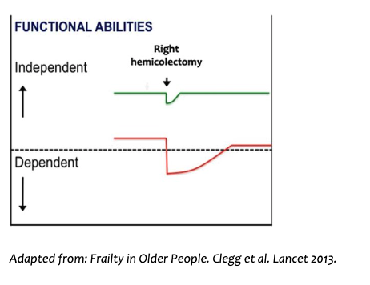
Surely the patient just needs surgery
TaP
Notes:
These slides were borrowed from Prof Susan Moug who is a colorectal surgeon at the RAH. She describes these two lines on the graph as Mr Green and Mr Red
Mr Green is diagnosed with colorectal cancer and after having the right side of his colon removed his health dips and then recovers to the same level of independence he enjoyed pre surgery.
Mr Red has some other health issues, including being a smoker his health dips significantly post surgery, he spends longer in hospital and never returns to the level of independence and health he enjoyed pre surgery

Slide 8
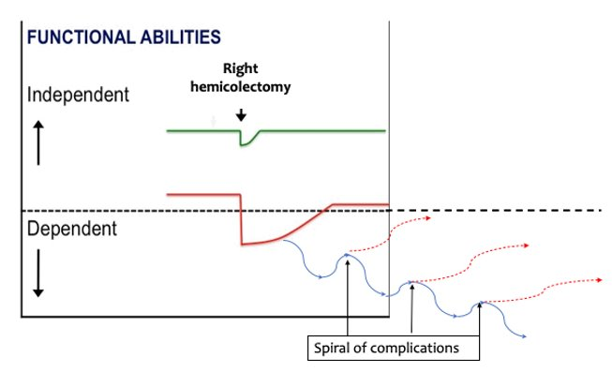
Surgery can make patients worse
Strategies are needed: Prehab
TaP
Prehab
Notes:
Prof Moug is a surgeon, but she is the first to say that sometimes surgery can make people worse, Mr red might acquire a chest infection while in hospital and then enter a spiral of complications that are successively harder to recover from and unfortunately some patients will never leave hospital.
CLICK
ERAS clinics are a strategy that supports patients like Mr Red, as is Prehab. It is a simple concept, to get Mr Red as close as possible to where Mr Green started for the best outcomes post surgery.
This applies to therapies as well, evidence shows that even a short intervention provides better outcomes, with patients reporting feeling more positive, and better able to deal with the challenges of their cancer journey

Slide 9
Challenges & Comorbidities
TaP
What kind of challenges and comorbidities do you see you in your patients that might make their recovery from surgery and cancer treatments difficult?
Notes:
I mentioned that Mr Red was a smoker, what other comorbidities do your patients present with, small group and then share

Slide 10
Referrals
TaP
Addiction
services
Weight management
Stop Smoking
Walking groups
Psychology
Physiotherapy
Speech &
Language
Live Active
Macmillan
Walking groups
Cancer Support
Groups
Dietetics
Maggie’s
Beatson
Physical
Emotional
Nutritional
Financial
Support Information Services
Improving the Cancer Journey
Notes:
What services would you refer them to? Shout out. Online version perhaps on paper in person? End of exercise. So you clearly recognise the other challenges your patients face.
Not sure if we need this

Slide 11



Mr. Red has been diagnosed with cancer
TaP

Slide 12

This is the clinician
TaP
Notes:
What is she thinking? Brainstorm
What is she feeling? Brainstorm

Slide 13
What stops her talking about Prehab?
TaP
Notes:
Brainstorm Repeat it back, no judgement on what is contributed, encourage discussion amongst group
To throw into the mix, not wanting to embarrass the patient by talking about their weight, smoking as a coping mechanism, patient is overwhelmed.
Not enough time could be an answer save this for planting the seed slide. Easier if consultant has planted the seed.

Slide 14

What might help her?
TaP
Notes:
Brainstrom would help
Consultant supporting her introducing the idea
Clear easy referral pathways
Speedy ICJ
Confidence
Time

Slide 15
Health Behaviour Change
TaP
Also known as breaking a habit
or creating a new one
Think of a time when someone you know change their health behaviour
What triggered it?
Was that trigger a positive or negative event?
One event or a series of events?
Notes:
We want our patients to engage with health behaviour change, but we are all human and most of us have probably had a go at changing a behaviour. In small groups think of a friend colleague patient or yourself who changed a long standing behaviour either by stopping something or starting something. Chewing finger nails example, it doesn’t have to be a huge isuue. You don’t have to share your story. Not all negative.
What motivated the change? Was there a trigger like a photo or becoming a parent?
And this event was it a single event or part of a series.
Teachable moments don’t always have to be on the back of a positive experience

Slide 16
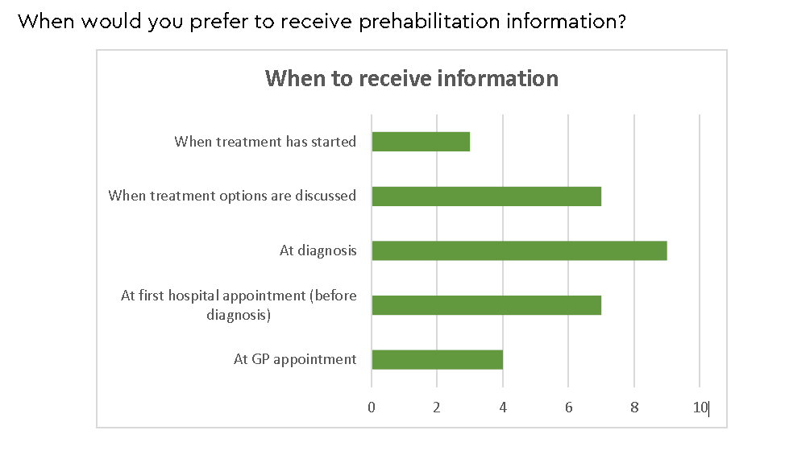
Knowledge is Power
TaP
..\2023 WOSCN - Prehab Final (3).pdf
Notes:
Statistics from WoSCAN and McMillan study with patients post treatment on Prehab
Some statistics from our colleagues int the stop smoking service
64% of clients setting a quit date with the stop smoking service in Hospital had never tried to quit before​
​
25% of cancer survivors have not been asked about their smoking in the past year: Journal of General Internal Medicine (2009) Coups et al. An assumption is made that these people know but they are choosing not to make a change.

Slide 17


Planting a seed
TaP
Notes:
As professionals you may not be the trigger for your patient’s behaviour change. But you might plant the seed. As you mentioned you may not have time to have a full prehab conversation so plant the seed. The next professional who mentions it might have more engagement because the time and place is right for the patient to change You can think of these as episodes of information for the patient. And remember it’s not your job to change your patient’s behaviour, you want to had them over to someone who specialises in that. . However, leaving a person to self refer has poorer outcomes, They have a better chance of taking up prehab if they are referred or given a warm hand over remember AHPs in the room

Slide 18
Mr. Red’s Pathway
TaP
R
Stop
Smoking
services
High Risk
Anaesthetic team
Bloods every 6 months for 3 or 5 years
All clear
P
P
P
R
GP referral
Poo test
P
Colono
scopy
USoC
CT SCAN
MRI
P
MDT
Meets
Clinic
Ap
Chemo
P
Pre
Assessment
Clinic
Ap
Pre
Assessment
Surgery
Clinic
Ap
Surgery
Chemo
P
P
P
3 months
Notes:
Let’s look at Mr Red’s pathway and see how many opportunities there are for a health professional to support him to stop smoking. Animated P are prehab opps. Optimised Approach
From his Poo test to the start of his Chemotherapy Mr Red has at least 5 clear opportunities. If the GP’s suggestion didn’t work it may be that the CNS that mentions it before he starts his chemo find he is finally in the right place to quit. We want to create an optimised approach for Prehab.
IfMr Red has prostate cancer and is put on Survallience he is still going to have a better quality of life as a non smoker.

Slide 19
What could she say?
TaP
.
Mr Red, Your recovery will be better if …
Professional
Non judgemental
Kind
There is evidence this will help
Empathetic
Notes:
Suggestions from the group, how would you broach the topic of prehab? Here are some suggestions for being overweight, smoking or feeling depressed And we will all know from our own experience as patients some how it is not what the clinician says, it’s HOW it is said. What qualities do you think are important? Qualities fly in Repeat ones that are shared. Thank them

Slide 20
Watering the seed
TaP
.
Mr Red, Are you feeling ready to stop smoking?
To get you ready your chemotherapy…
Notes:
QUICK with this. And you can revisit them later, your patient might be waiting to be asked Watering the seed Realistic Medicine the Bran questions or do we lose this slide?
Benefits Risks Alternatives Nothing

Slide 21

Back it up with a letter or leaflet
TaP
We recommend that you attend…
Third sector agencies will print
Opportunity to process the information at home
Prehab and Me website
Notes:
If you are referring onto a third sector charity they will be happy to develop and print letters that people can take away with them and reflect upon at home, when they may not be feeling so overwhelmed.

Slide 22
The Patient Experience
TaP
Apple Clinic at the IRH
LINK HERE – Vimeo Account
Notes:
This is a patient story from a prehab trial that Mhairi Burk a physio at the IRH is running.
End of video, it’s important to remember that one of the best outcomes from Prehab that is hard to measure is that patients feel more in control. Some patients will enjoy the community they find in prehab activities but even for people who would rather Prehab on their own in private, the emotional benefits are great.
Cue up at 2:36 end at 6:34

Slide 23
Talk about Prehab
TaP
You wouldn’t run a marathon without preparing for it
Plant the seed
Point of diagnosis can be a teachable moment
Refer for ‘a warm hand over’
Prehab and Me or other take away
Revisit it, water the seed
Visit our resources on Staffnet
Home

Slide 24
Some Prehab Providers
TaP
Maggie's, Glasgow | Maggie’s
Home | Beatson Cancer Charity
Cancer information and support | Macmillan Cancer Support
Local ICJ
Weight management
Stop smoking
Addiction services
Spiritual Care
Notes:
Lose this for Staff net Page Hand out
We will send you links to our staff net page which has more resources but here are a few of the bigger providers of third sector prehab

Slide 25
Prehab Learning Opportunities
TaP
Prehab and Me – Prehabilitation for Scotland
PRosPer - Cancer Prehabilitation and Rehabilitation - elearning for healthcare
Behaviour change for health | NHS Education for Scotland
Notes:
Lose this for Staff net Page Hand out
MAP
PRosPer
Prehab and me

Slide 26
Learning Objectives
TaP
Gain a better understanding of Prehab
Feel more confident talking about Prehab with a person diagnosed with cancer
Feel more confident about when to talk about Prehab
Talking
about
Prehab
Notes:
Our learning outcomes, please consider if you think these were met when you feed back on this session

Slide 27
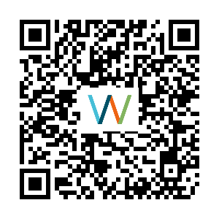
Questions & Feedback please
TaP
Thank you,
mary.watson6@nhs.scot
joe.jones@nhs.scot
Notes:
Does anyone have any questions?
Thi
https://link.webropol.com/s/TaPfeedback
s is a new session so we need your feedback to see how you found it or if you think it could be improved. Link, QR or paper feedback form

